Slide 1

Ekaterinburg State
Theatre Institute

Slide 2
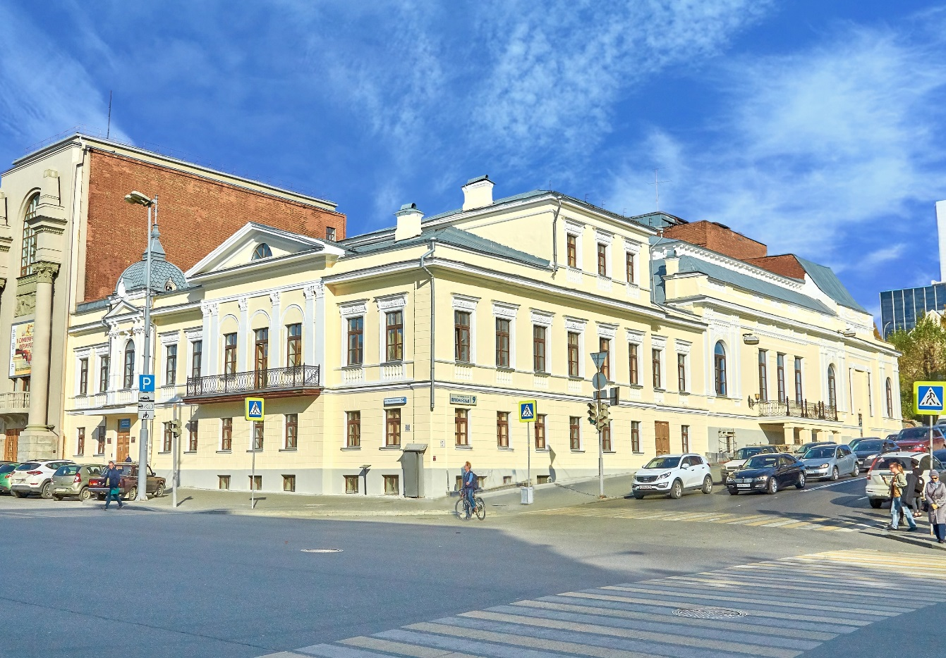
Ekaterinburg State
Theatre Institute
The Institute, founded in 1985, is the only specialized higher education organisation in the Urals region that provides education in the field of skilled theatre workforce and train students in the following careers:
Acting
Theatre Directing
Creative Writing
Producing

Slide 3
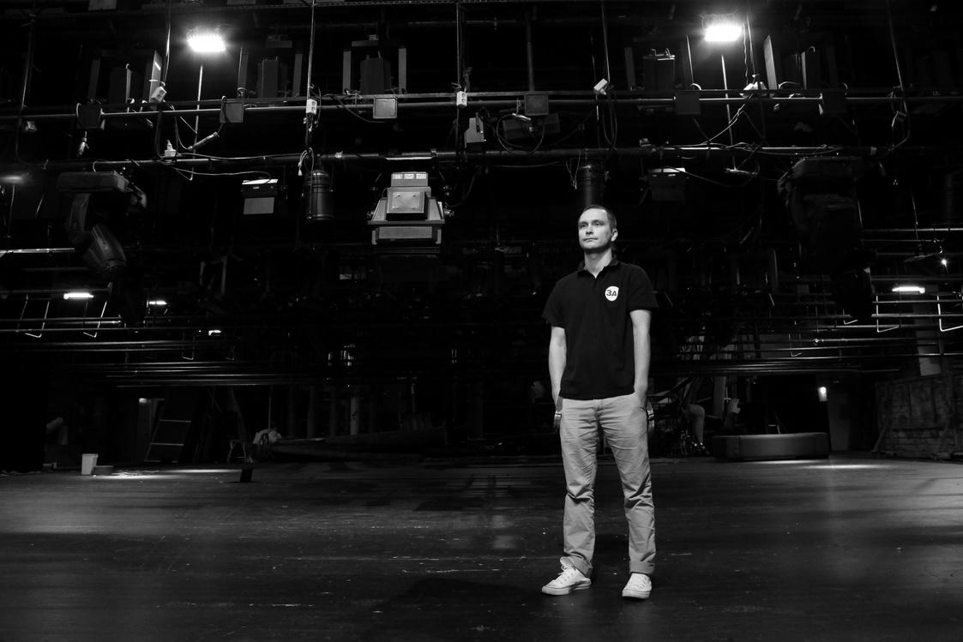
Ekaterinburg State
Theatre Institute
MORE THAN 5000 GRADUATES
The Institute graduates work at theatres, concert halls, film productions, shows etc. all over the world.
They develop their own theatre projects, write plays and act in films.

Slide 4
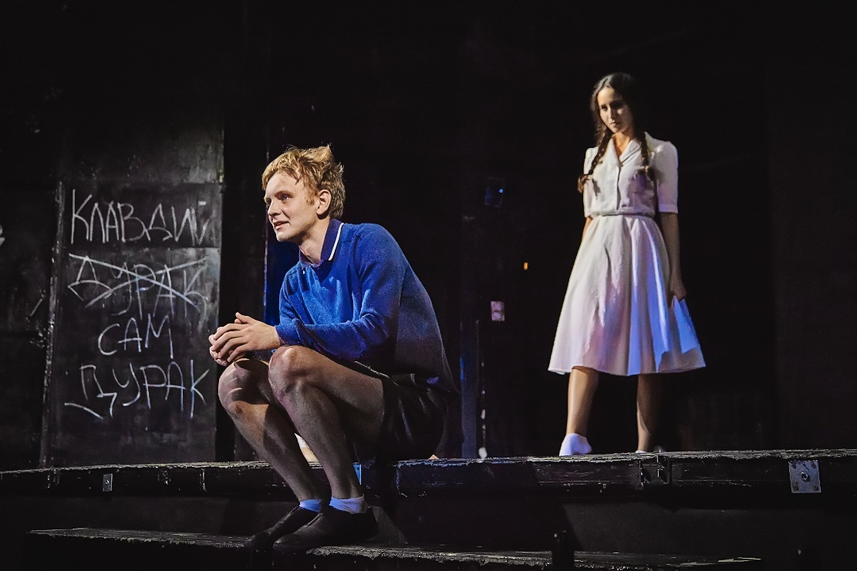
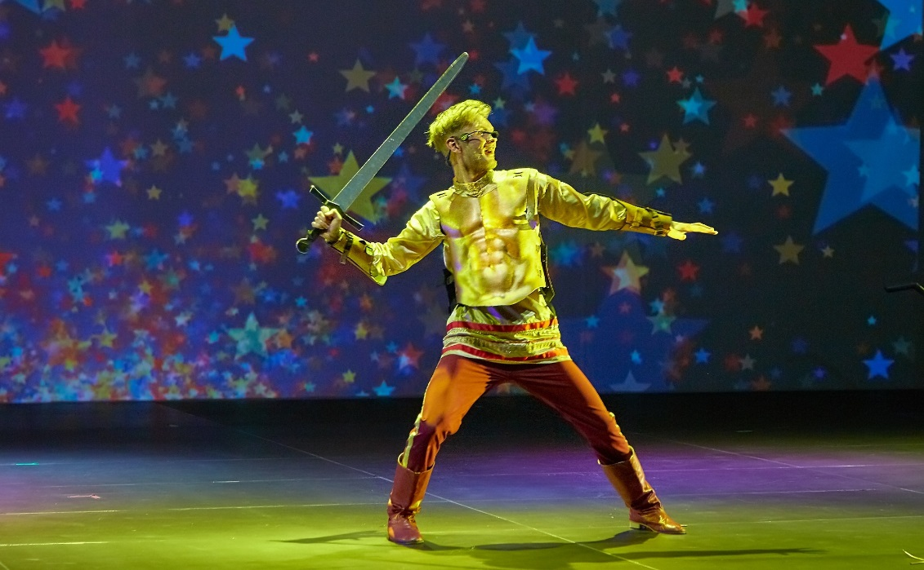
Ekaterinburg State
Theatre Institute
The ETI students hone their acting skills on the stage of the Student Theatre in dramatic, musical and puppet performances
The repertoire of the Student Theatre includes performances for children and adults

Slide 5

Ekaterinburg State
Theatre Institute
The International Festival of Small Forms and Mono Performances “He. She. They” was held at the ESTI in April 2019.
Spectators saw about 20 productions performed in the classical style, including musical and poetic shows, as well as experimental production like immersive performances with the audience participation.
The jury consisted of prominent figures of Russian Theatre.
The purpose of the festival is to popularize small-scale performances and prove that in the solo performance the actor on the stage “is an island” if it is embodied with talent and brilliance.

Slide 6
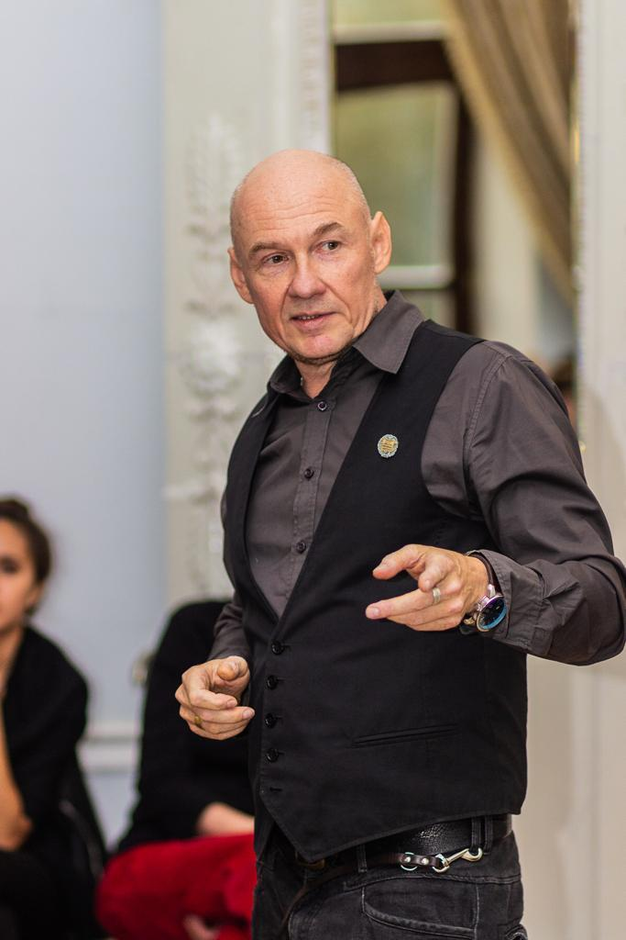
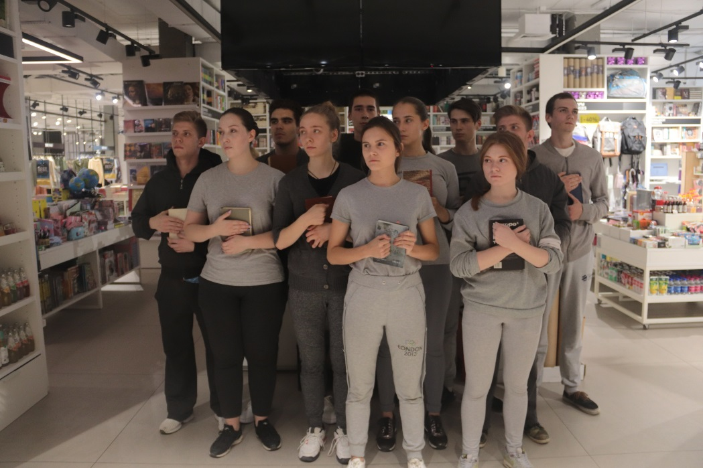
Ekaterinburg State
Theatre Institute
In 2019 students from Russian and foreign universities took part in the Student Directing and Acting Laboratory “Interior Space” held by the Institute.

Slide 7
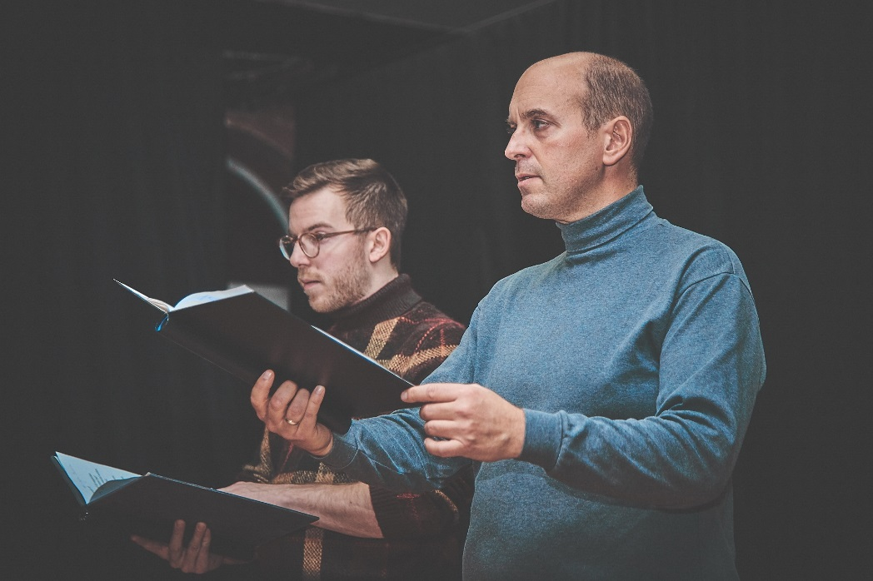
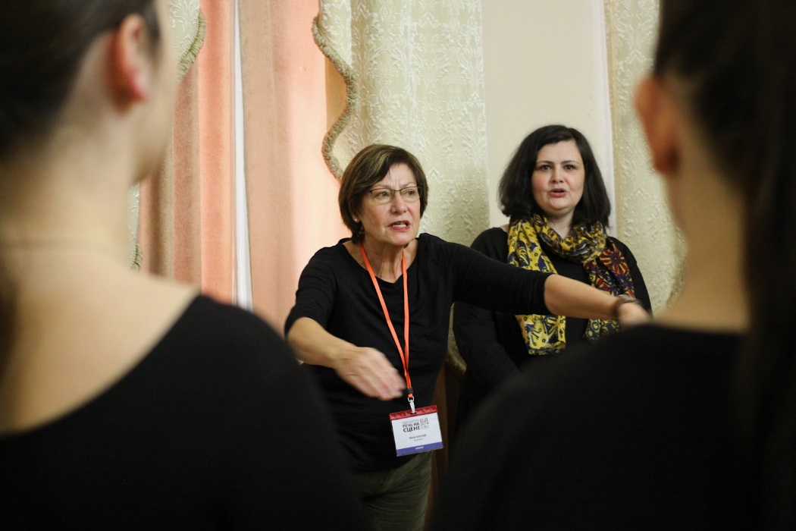
Ekaterinburg State
Theatre Institute
Master classes and workshops are regularly held by specialists from various theatre schools.

Slide 8
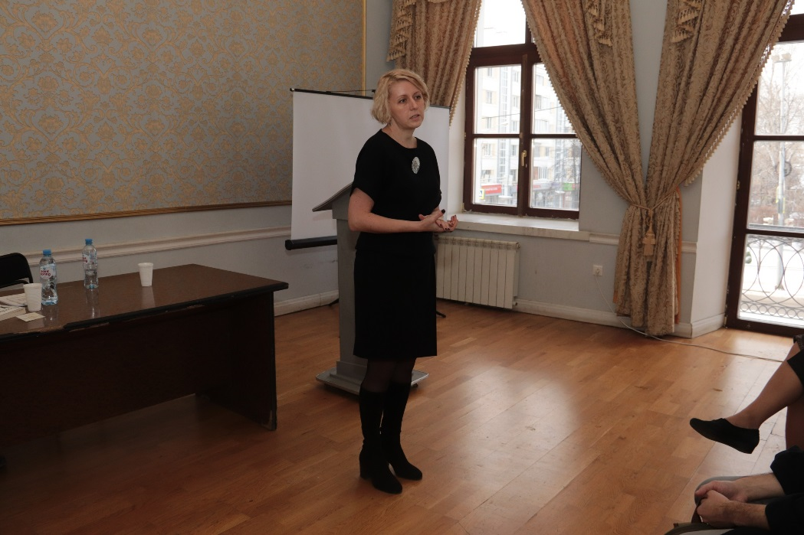
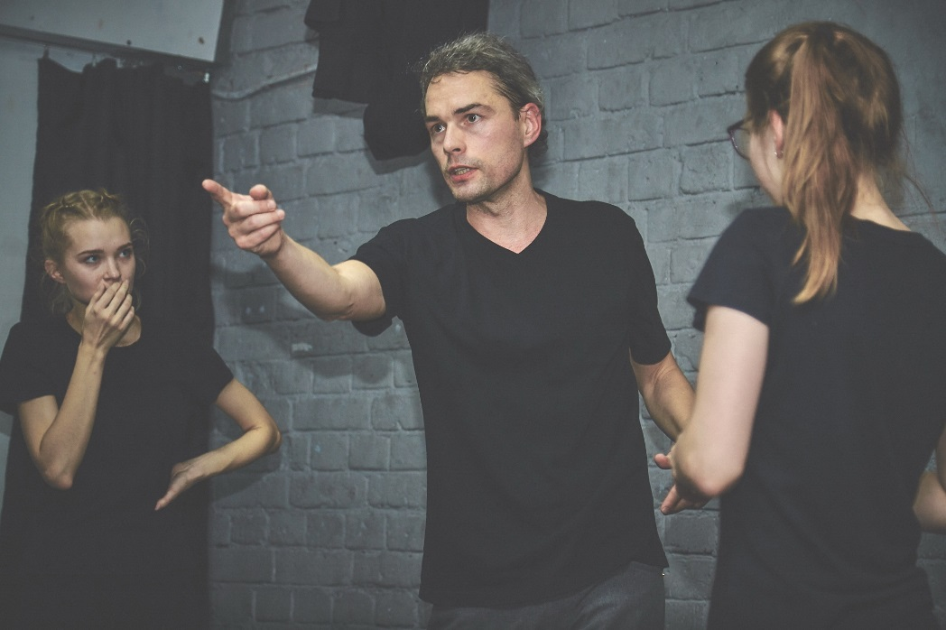
Ekaterinburg State
Theatre Institute
The ESTI annually holds scientific and practical conferences and seminars in substantive areas:
“Speech on the Stage”, “Theatre Text”, “Theatre in Context”

Slide 9
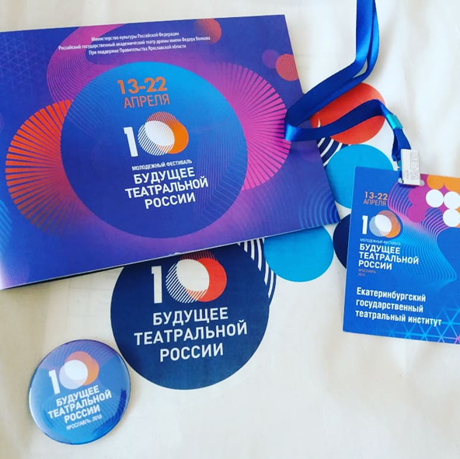
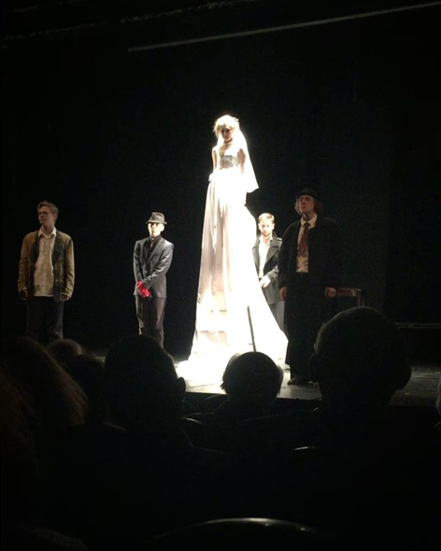
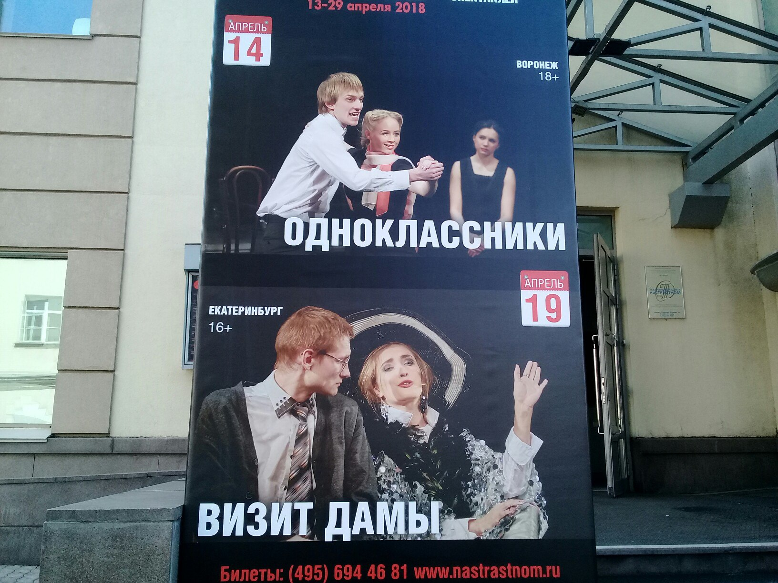
Ekaterinburg State
Theatre Institute
The ESTI students are participants and winners of prestigious national and international competitions and festivals:
Moscow International Theatre Festival of Student
Performances "Your Chance"
All-Russian Youth Festival "The Future of Theater Russia" (BTR)
Anton Pavlovich Chekhov International Reciting Competition
and others.

Slide 10
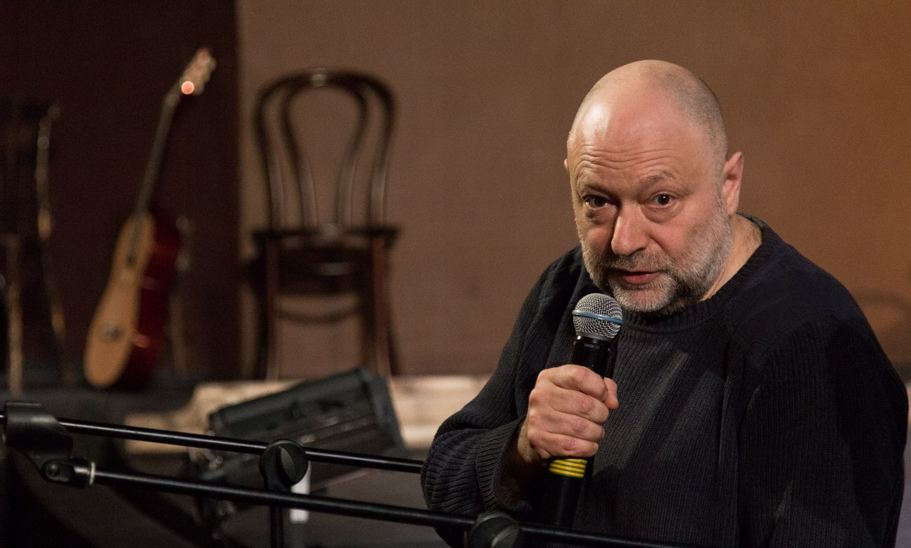
Ekaterinburg State
Theatre Institute
The ESTI provides supplementary courses for children and continuing education programmes for adults in substantive areas, as well as the professional retraining programmes with leading theatre teachers:
Drama Director (master of the course - associate professor of the Russian State Institute of Performing Arts, Laureate of the RF State Prize A. A. Praudin)
Children on Stage (the basics of acting for children)
Acting Art
Scenic Speech
Stage Movement

Slide 11
Ekaterinburg State
Theatre Institute
In future new programmes are to be open:
Bachelor’s programme in Performance Decoration Technology
Assistant internships in Stage Speech
Masters in Theater Arts

Slide 12
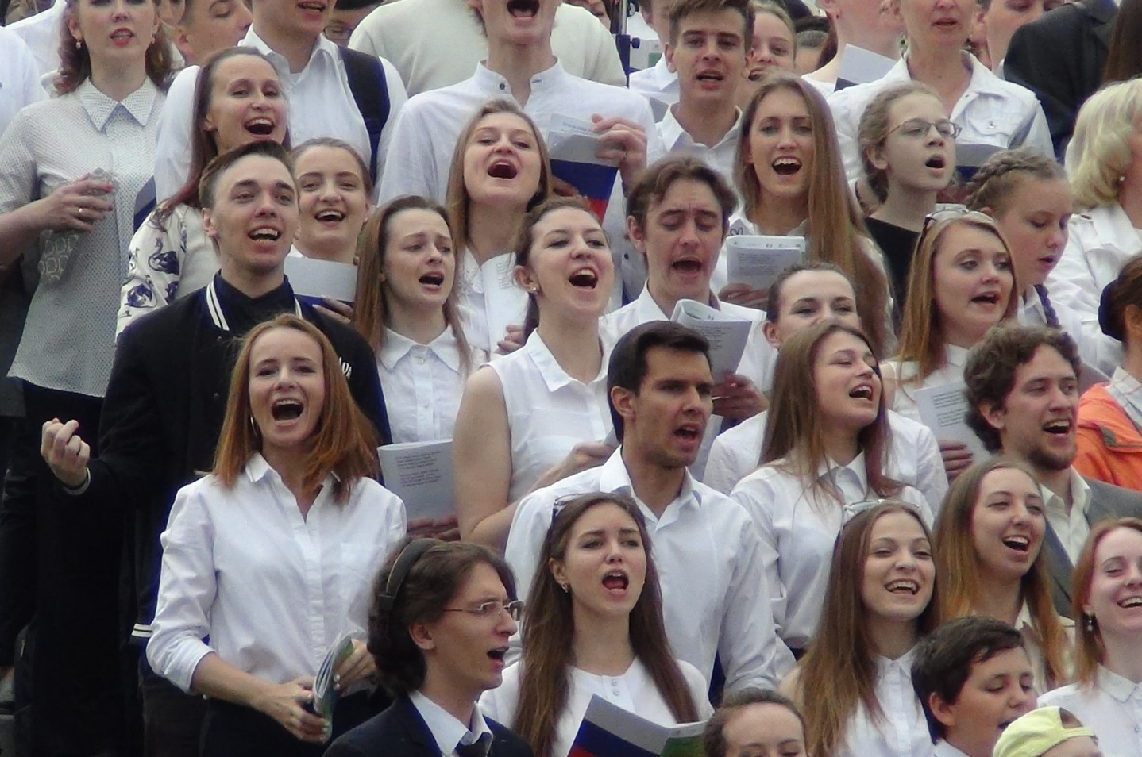
Ekaterinburg State
Theatre Institute
The ESTI students take an active part in important social events: Day of Russia celebrations, student interuniversity projects, perform charity concerts and shows in hospitals, schools, and social welfare organisations

Slide 13
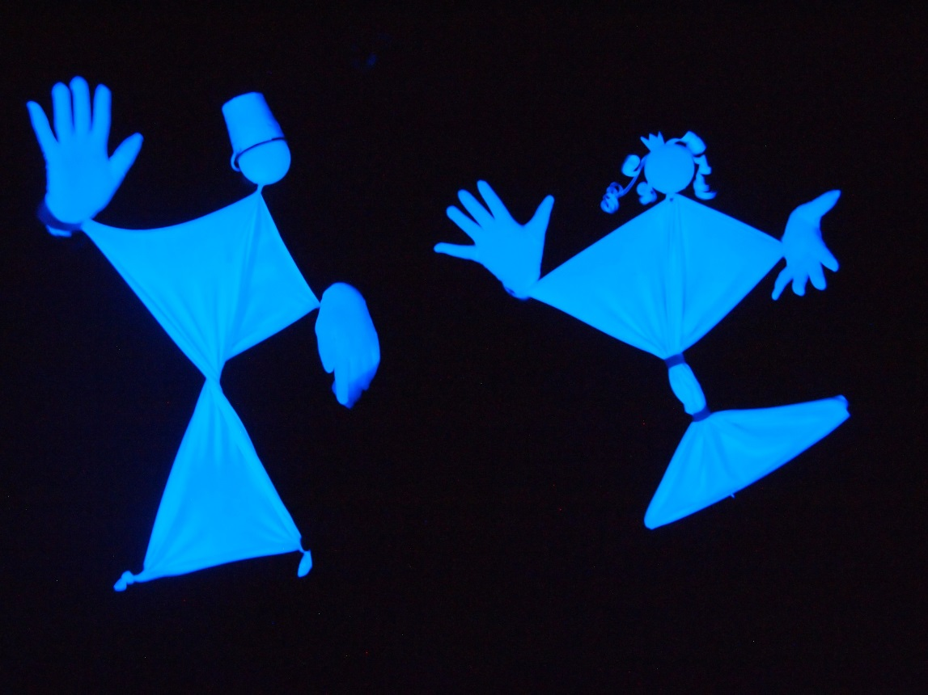
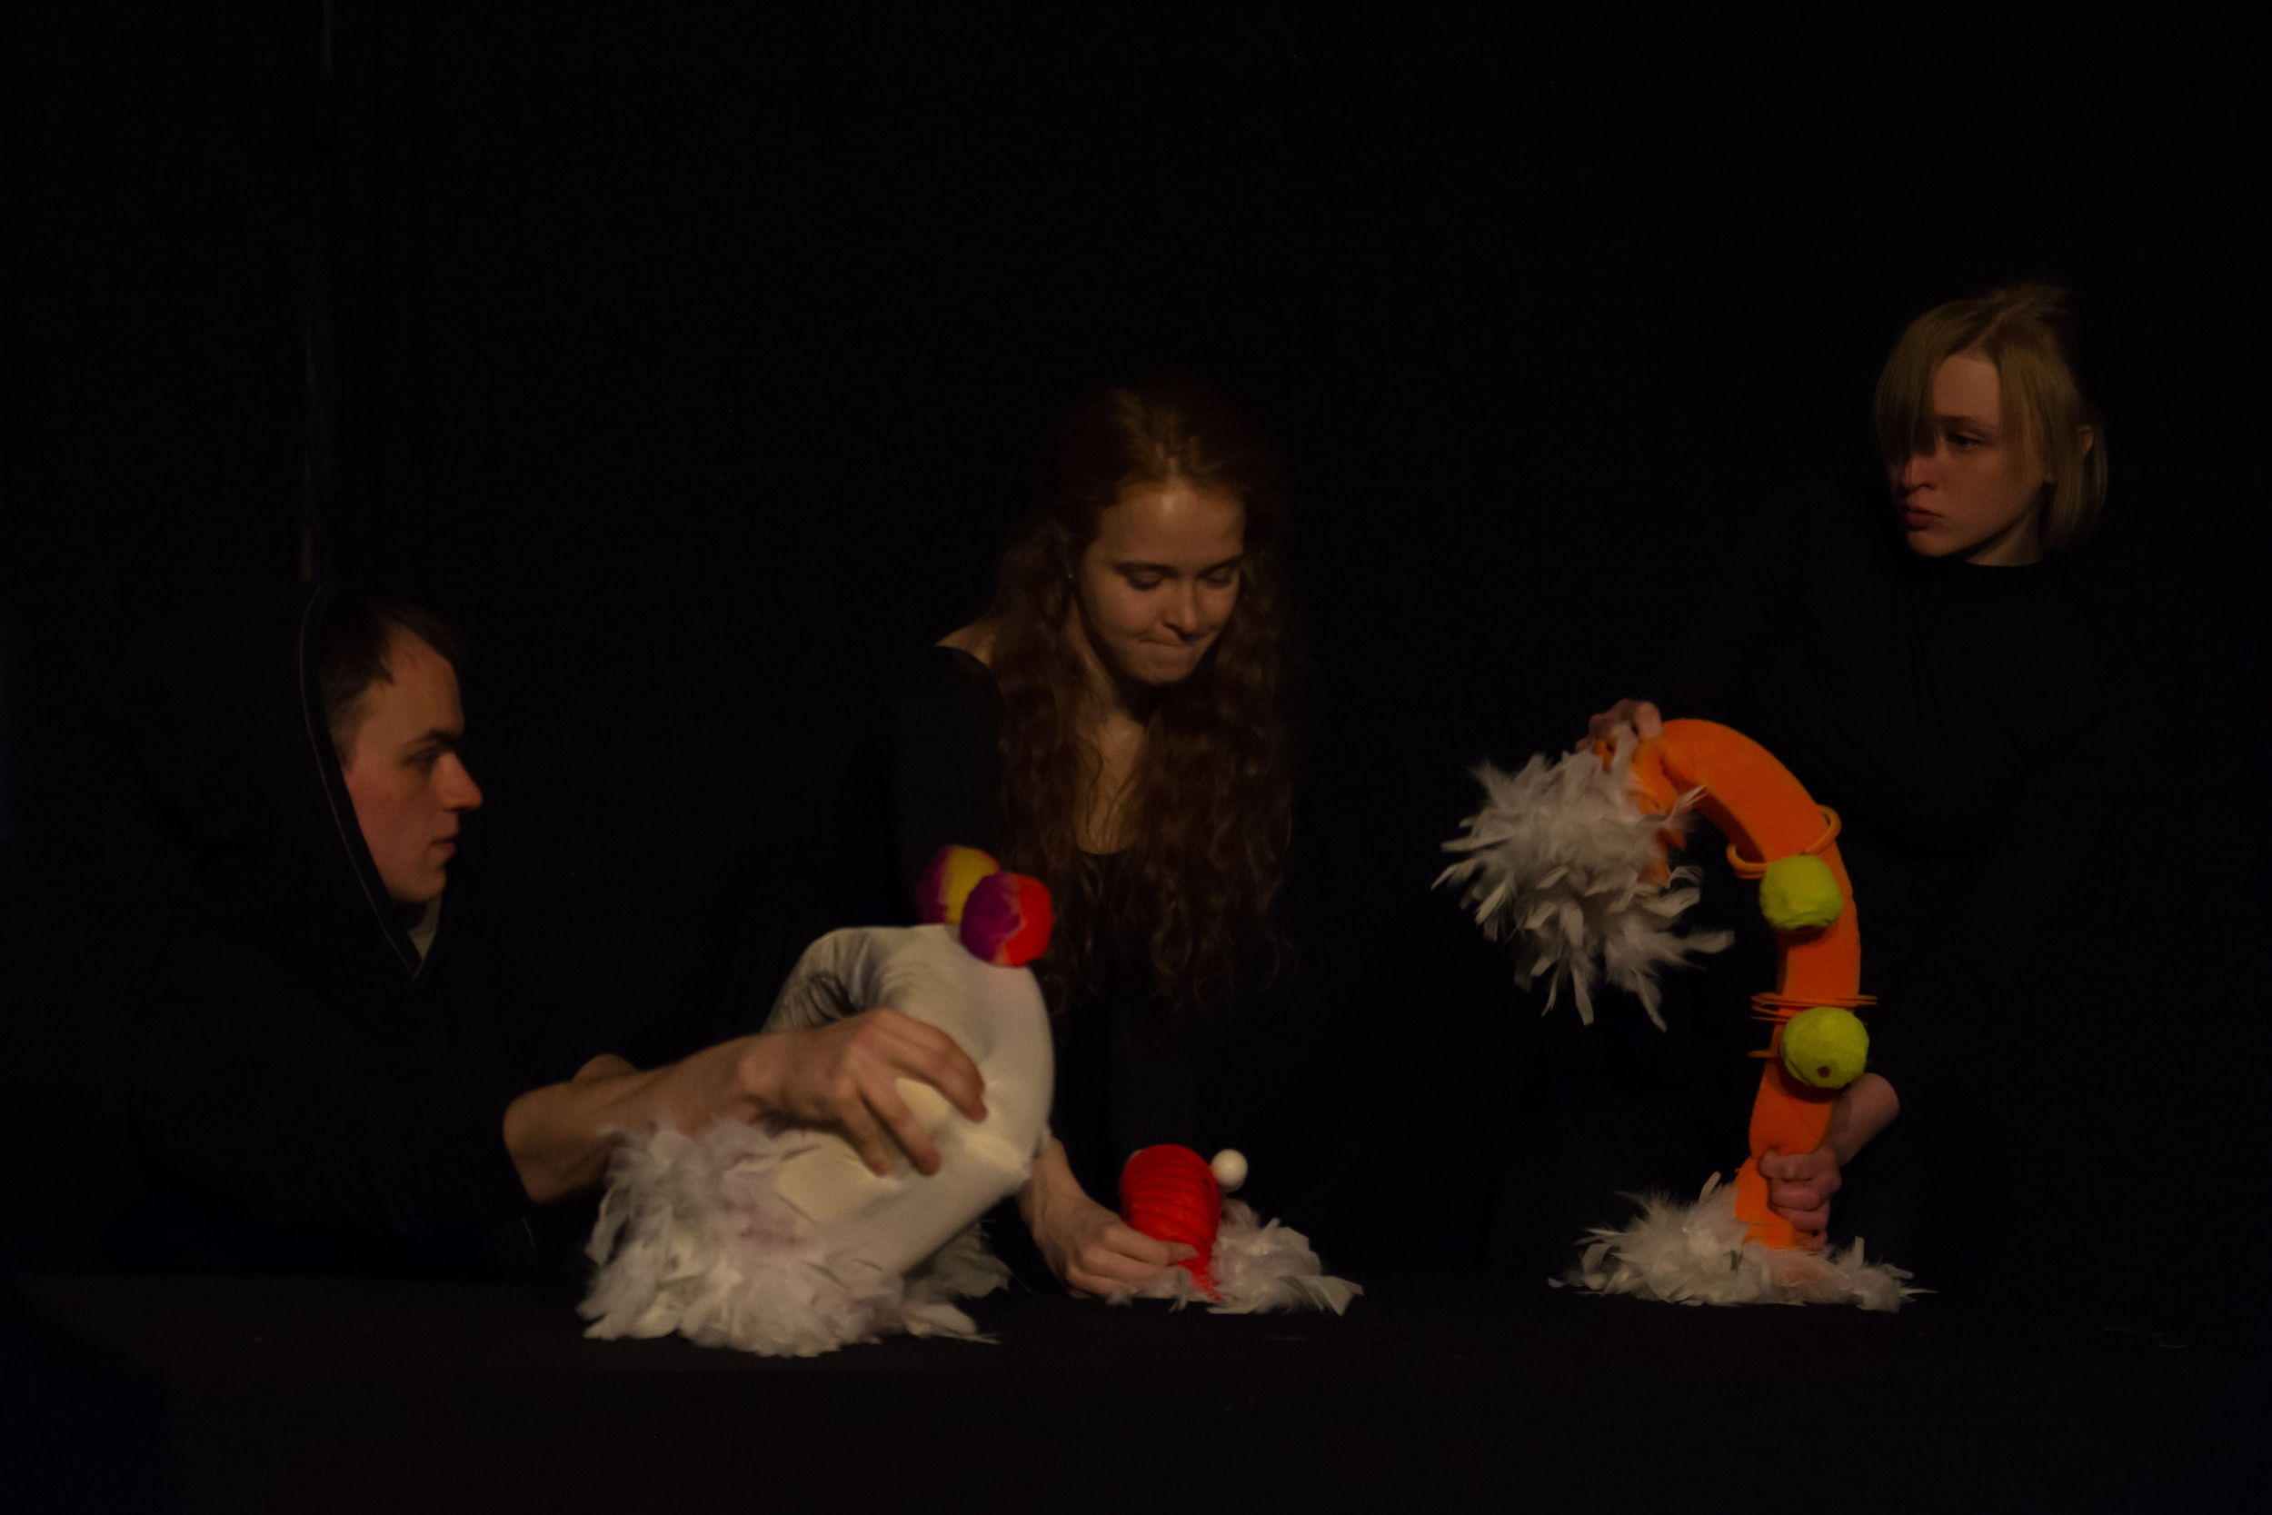
Ekaterinburg State
Theatre Institute
Museum Night -2019
Theatre Summer Camp

Slide 14
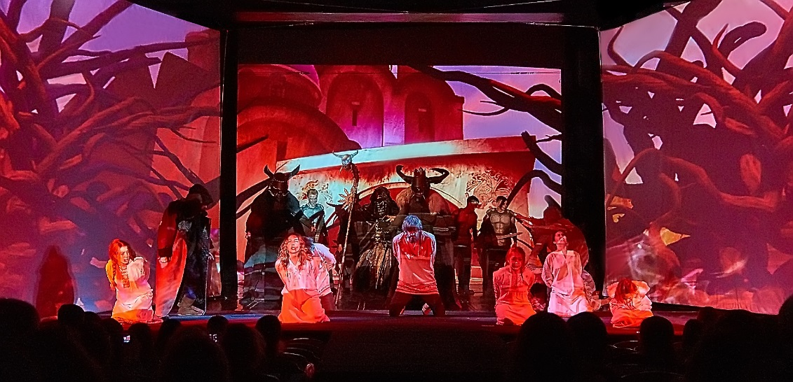
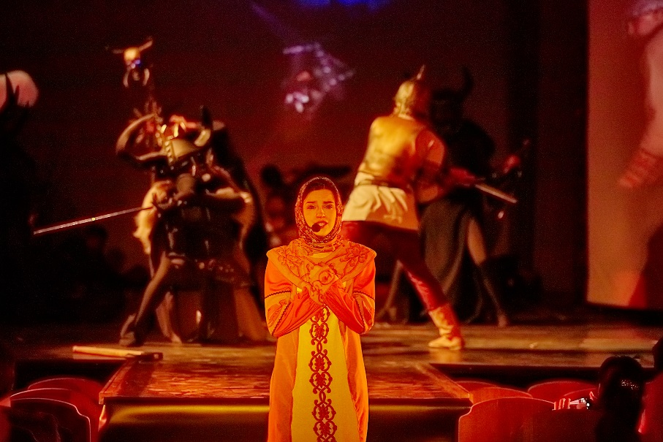
Ekaterinburg State
Theatre Institute
The Multimedia Theatre was created on the basis of one of the class of Alexander Blinov. It combines traditional acting and the use of 3D technology

Slide 15

Ekaterinburg State
Theatre Institute
st.Weiner, 2, Ekaterinburg, Russia, 620014
(343) 371-76-45, r_egti@mail.ru
www.egti.ru

